Slide 1
Topic modeling
Team Members
Abhijeet
Priyanka
Tejaswini
Kumar Sanu
Bhaskar
maheshwari

Slide 2

Project- TOPIC MODELING
Business Objective:
Social event tracking and evolution framework to obtain the evolutionary trends of social events and generate effective event summary details over time. The input is the textual data collected from various social media. Based on the input data, our algorithm can learn multi-modality topics and track multiple events. After tracking, for each event, it can be visualized with texts and image over time. .
After creating the topics, You can create the topics as different clusters and then whenever you pass a new data, Your model should classify to which cluster your article belongs to

Slide 3
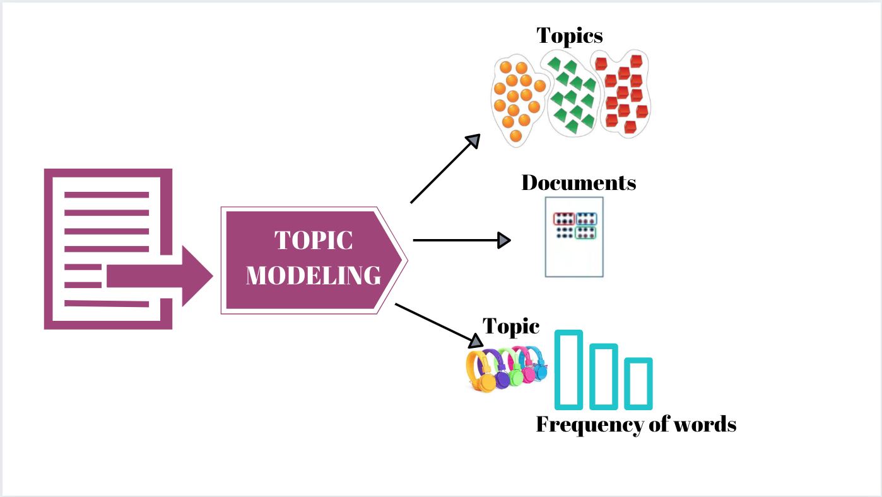
Topic extraction flow
WebScrapping Webdata

Slide 4

WebScrapping
Web scraping is the process of collecting structured web data in an automated fashion. It's also called web data extraction.
Getting the data source from Wikipedia
We get information for three different subjects:
Statistics
Politics
Social Media
Parsing the data by using BeautifulSoup Object
Fetching the data
Preprocessing the unstructured data
Preparing the Data

Slide 5

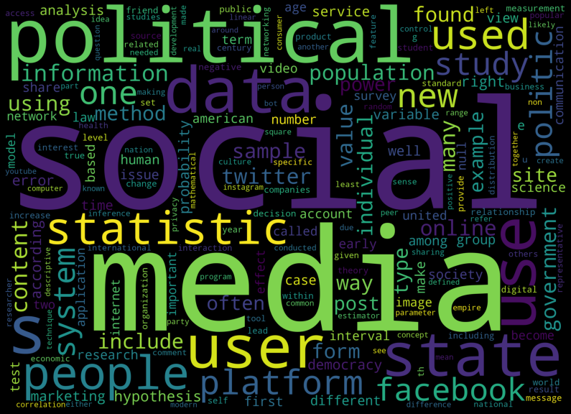
Topic Modeling using pyCareT
Installing Pycaret
Load the dataset
Setting up Environment in PyCaret (Using Setup function)
Convert text into List format
Generate the WordCloud

Slide 6
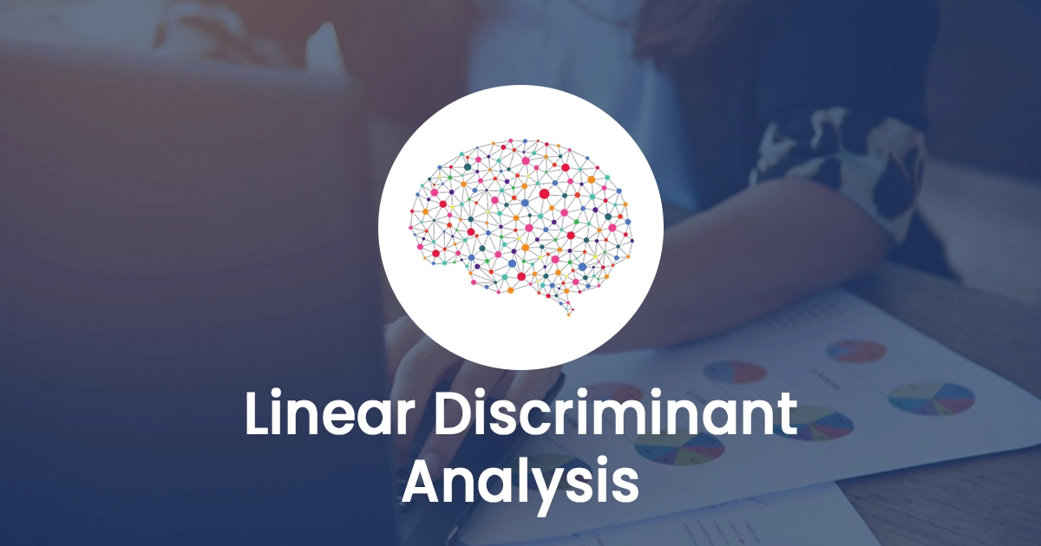
CreaTE a Topic Model by using lda
Linear discriminant analysis (LDA) is a type of linear combination, a mathematical process using various data items and applying functions to that set to separately analyze multiple classes of objects or items.
Create a Topic Model
A topic model is created using create_model() by using LDA
Assign Model
By using assign model() assign the topic proportions to our dataset to analyze the results.
We get five different topics by using assign model()
Researches, Statistics, Social_medium, Politic, Democracy

Slide 7
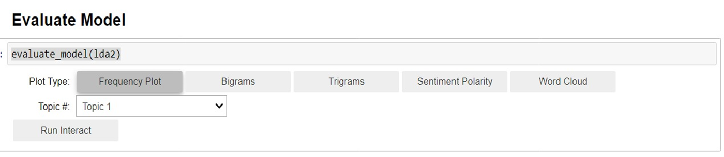
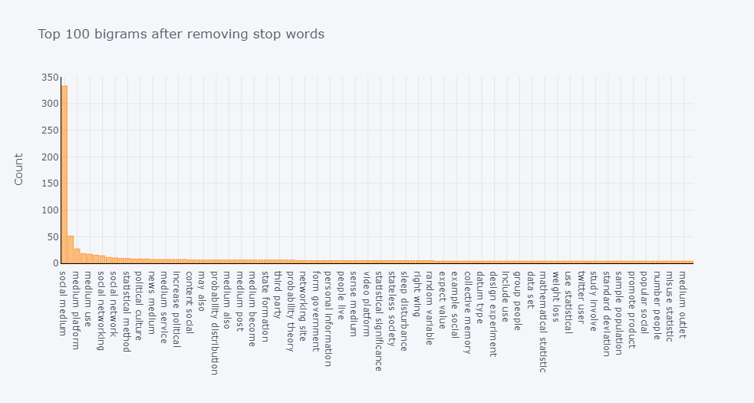
Biagram

Slide 8
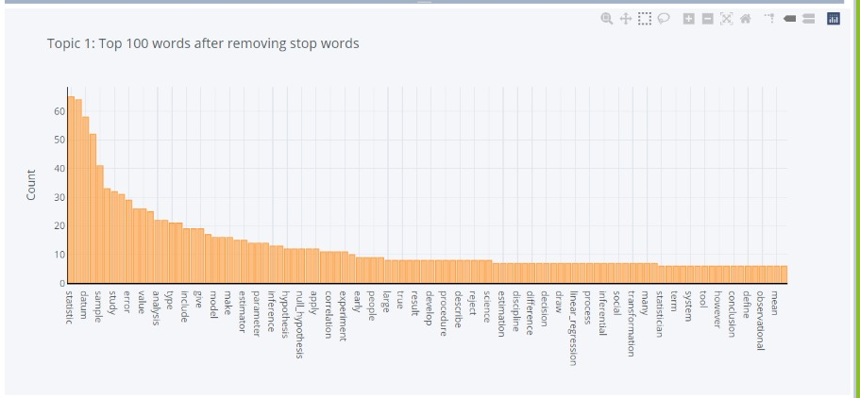
Frequency Distribution of Topic 1

Slide 9
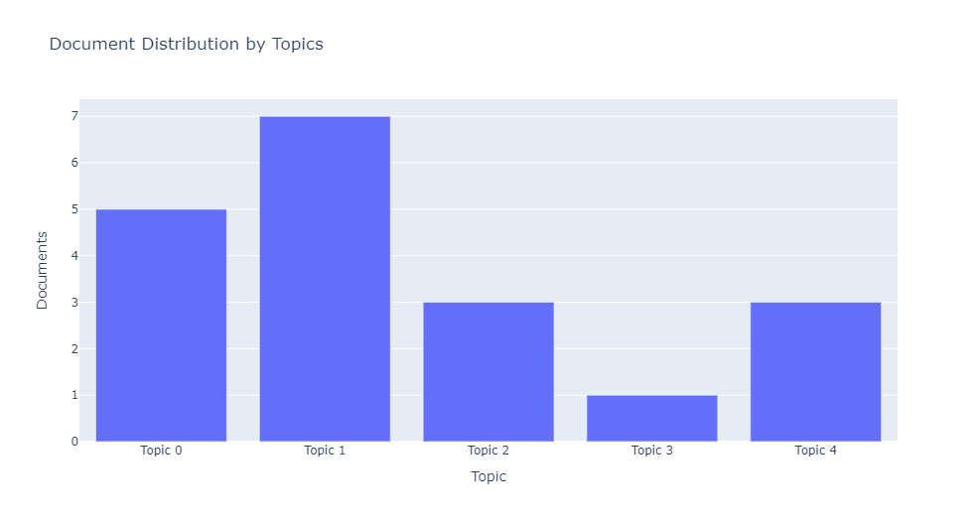
Topic Distribution

Slide 10
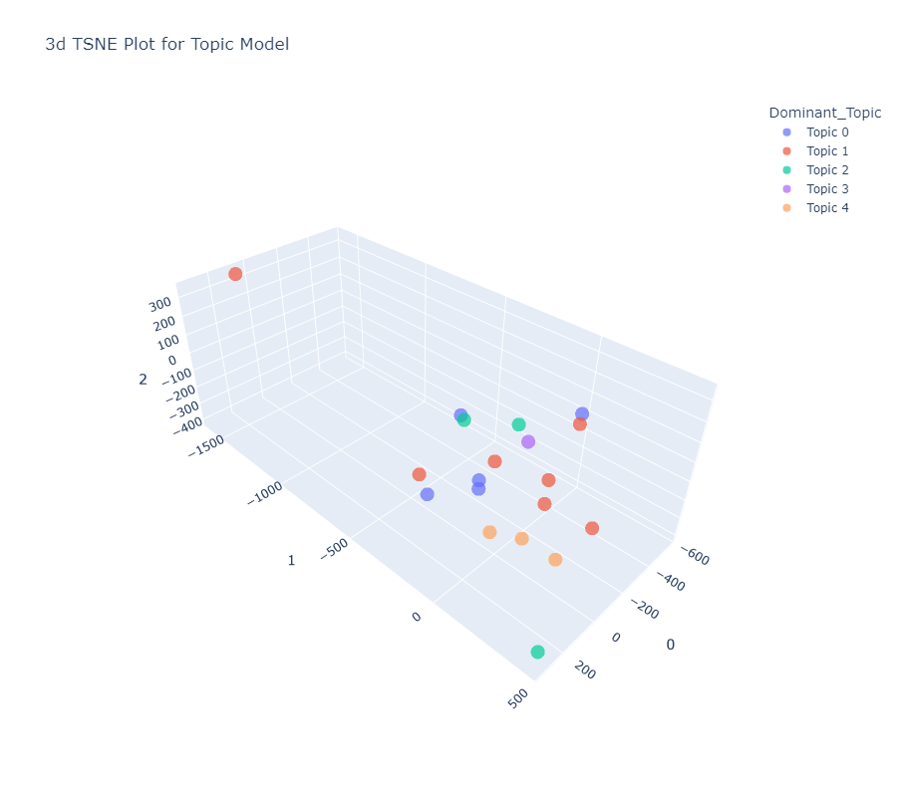
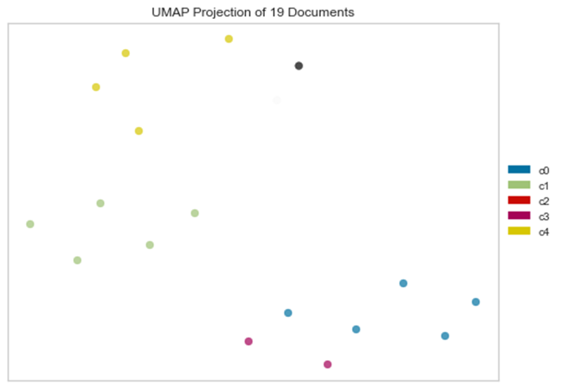
T-distributed Stochastic Neighbor Embedding (t-SNE)
Uniform Manifold Approximation and Projection Plot

Slide 11
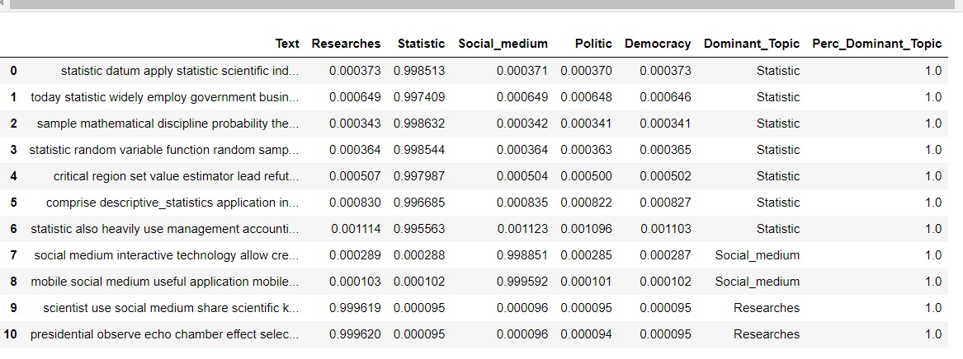
DATASET:- After evaluating LDA we get below five topics in Dataset

Slide 12
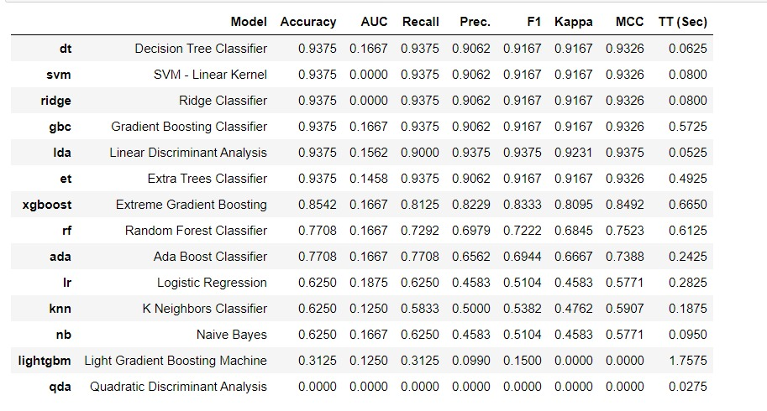
Model Building(classification)
Below are the model performances on the basis of Multi Classification

Slide 13
Finalize the model
We have finalize the Linear Discriminant Analysis Model on the basis of evaluation of performances of the models which gives best and consistent performance.
Accuracy of Linear Discriminant Analysis Model= 0.9375

Slide 14
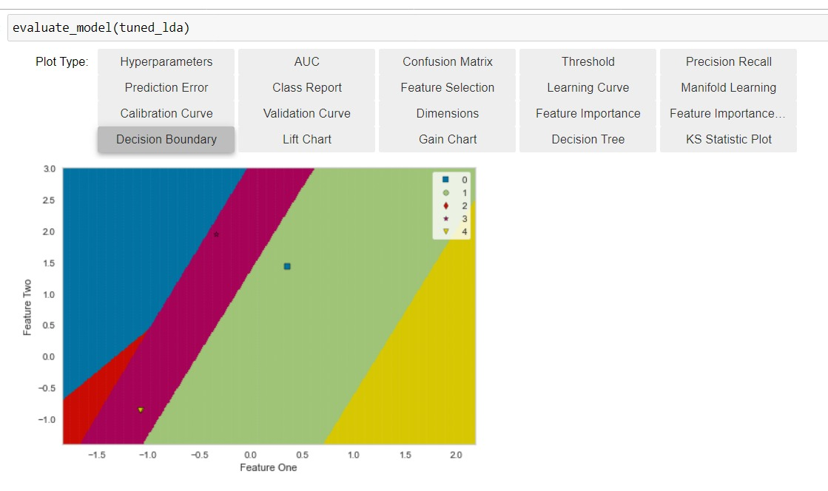
Evaluate model
To analyze performance of models is to use evaluate_model(tuned_et) function which tuned Hyperparameters.

Slide 15
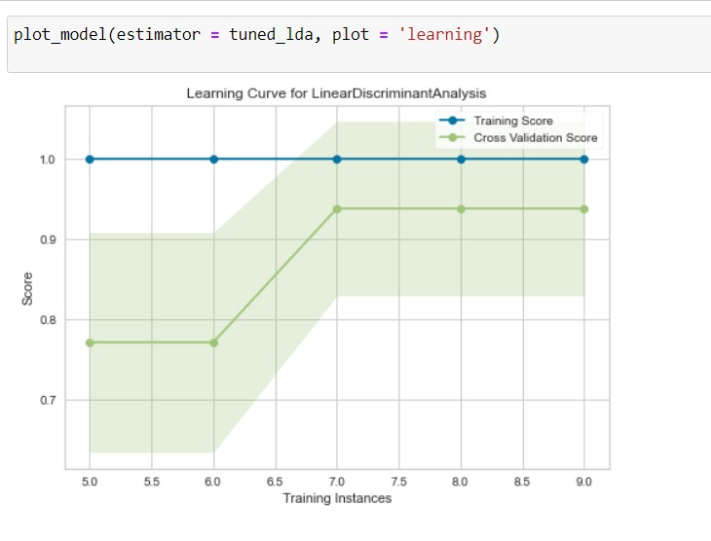
Learning Curve for Linear Discriminant Analysis (LDA)

Slide 16
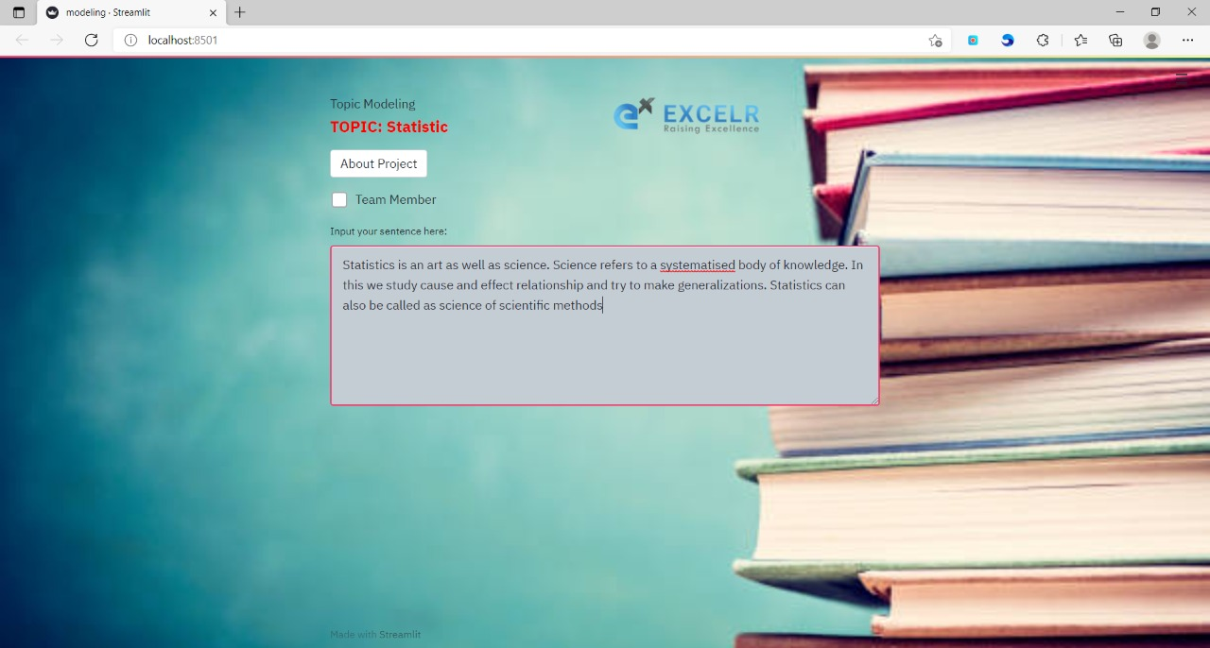
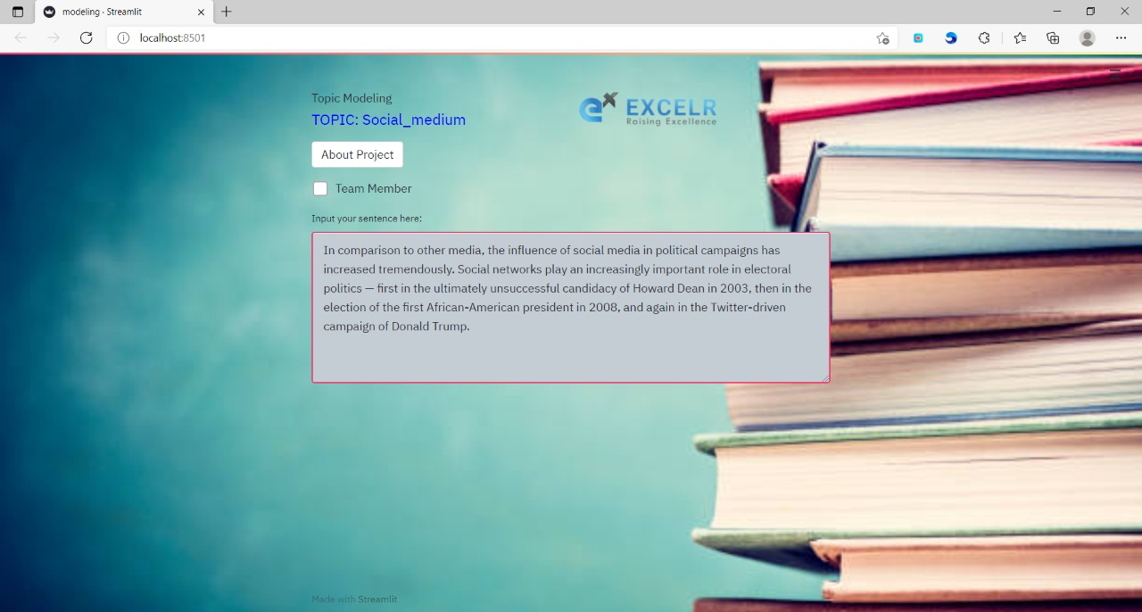
Deployment of the model
We used Streamlit for the Deployment of the Model

Slide 17
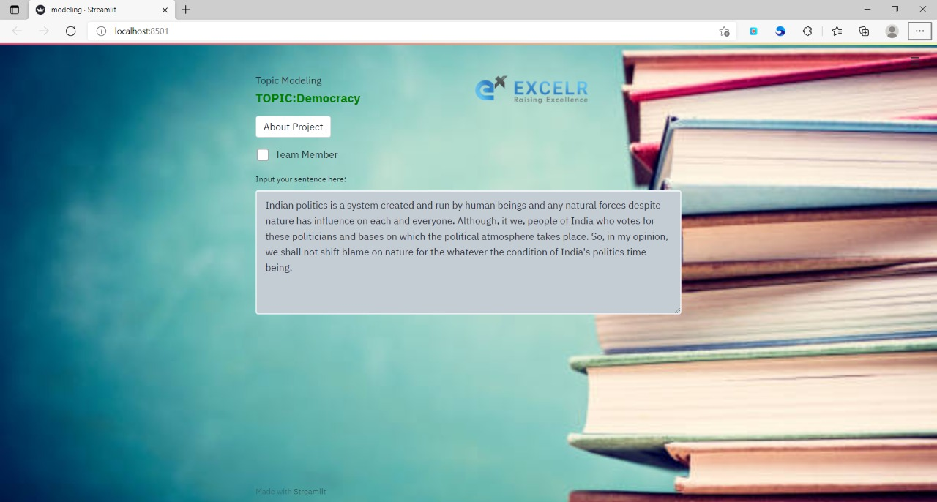

Deployment of the model

Slide 18

Challenges
1 Error during installing packages like Pycaret.
2 We had facing visualization issues due to large image size
3 Accuracy variation
4.Converting text into topic
5. Facing issues while loading pickle file in deployment
Overcome
1 After updating packages related pycaret we overcome the error
2 After applying session id we got consistent Accuracy

